Slide 1

FINANCIAL ENGINEERING PROJECT Stage 5
POZNAN UNIVERSITY OF ECONOMICS AND BUSINESS
Students:
Tu Anh Nguyen
Thi Kim Phuong Nguyen
Askar Mulkubayev
Osborn Mugaviri

Slide 2

Content
CVA Definition
CVA calculation for the analyzed derivatives
How the CVA at portfolio level is impacted by introduction of the variation margin
Sensitivity analysis

Slide 3
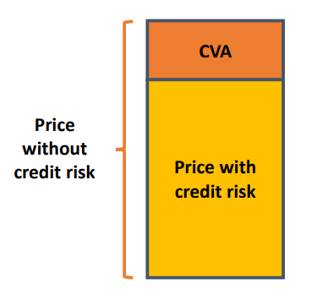
I. CVA Definition
Credit Valuation Adjustment (CVA) is the price that an investor would pay to hedge the counterparty credit risk of a derivative instrument. It reduces the mark to market value of an asset by the value of the CVA.
CVA is basically difference between true value of portfolio and risk – free value of the portfolio.
(Source: Credit valuation adjustment for derivative contracts – Dr. Paweł Olsza)

Slide 4
I. CVA Definition
CVA was introduced as a new requirement for fair value accounting during the 2007-2008 Global Financial Crisis. Since its introduction, it has attracted dozens of derivatives market participants, and most of them have incorporated CVA in deal pricing.
CVA is developed in a response to government and corporate defaults. Such as Argentina, Russia, WorldCom, Lehman Brothers
Notes:
The counterparty credit risk is the risk that counterparty defaults before the contract matures
Counterparty credit risk (CCR) is the risk that the counterparty to a transaction could default before the final settlement of the transaction's cash flows. An economic loss would occur if the transactions or portfolio of transactions with the counterparty has a positive economic value at the time of default. Unlike a firm's exposure to credit risk through a loan, where the exposure to credit risk is unilateral and only the lending bank faces the risk of loss, CCR creates a bilateral risk of loss: the market value of the transaction can be positive or negative to either counterparty to the transaction. The market value is uncertain and can vary over time with the movement of underlying market factors.

Slide 5
I. CVA Definition
Purpose
- Reflect the credit risk of a counterparty within the value of an entity’s derivative holdings. Issuers of derivatives routinely do this in order to ensure they are adequately compensated for the credit risk that they bear.

Slide 6
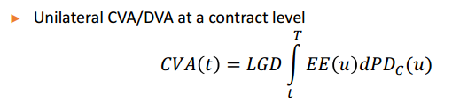
I. CVA Definition
The basic formula for CVA calculation:
Where:
LGD – Loss given default (The percentage amount that a party expects to lose if the counterparty defaults)
EE(u) – present value of expected exposure
PD_{c}(u) – default probability

Slide 7
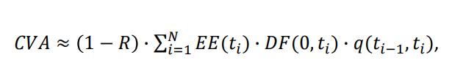
I. CVA Definition
The formula for calculating CVA is applied in this project:
Where:
EE(t_{i}) - Expected exposure within t_{i}
DF(0, t_{i}) – discount rate for the term t_{i}
q(t_{i-1}, t_{i}) = PS(t_{i-1}) – PS(t_{i}) – probability of counterparty’s default for period from t_{i-1} to t_{i}
PS(t_{i}) – survival probability within t_{i}
R – Recover rate
N – number of analyzed points (grid size)

Slide 8
II. CVA calculation for the analyzed derivatives
Simulate 10 000 paths for each time step
Calculate FX valuation, IRS valuation and Portfolio NPV
Calculate exposure of IRS, exposure of FX, exposure of portfolio for each time step, each path.
Calculate CVA for FX, IRS and portfolio

Slide 9
II. CVA calculation for the analyzed derivatives
Used parameters were estimated/ calibrated from historical data.
Parameter | Value | Estimation
Correlation | 0.12 | Correlation between two underlying assets (EUR/PLN and Euribor-3M) was estimated using 3 years data
r-rf | 2.12% | Estimation of average difference between Wibor-3M and Euribor-3M was used, excluding period of Covid-19 outbreak
Sigma (FX) | 5.31% | Average standard deviation of EUR/PLN for 3 years was used as an estimate
Lambda (IRS) | 0.63 | Lambda for Hull-White model Euribor-3M rate was estimated using linear regression method
Mu (IRS) | -0.4% | Lambda for Hull-White model Euribor-3M rate was estimated using linear regression method
Sigma (IRS) | 0.11% | Sigma for Hull-White model for Euribor-3M rate was estimated using linear regression method

Slide 10
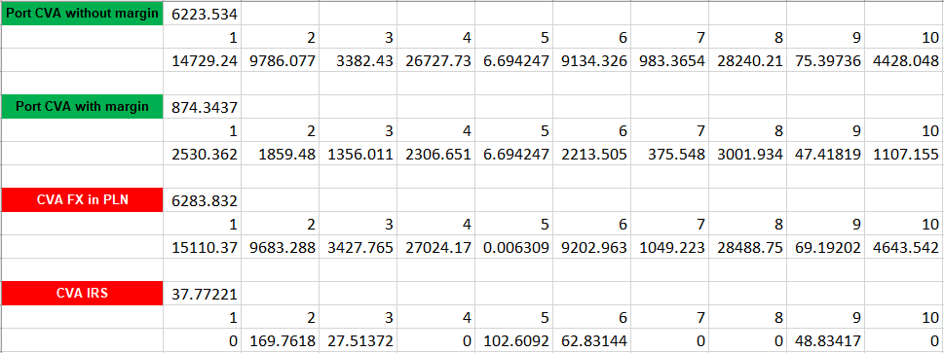
II. CVA calculation for the analyzed derivatives
The average result of CVA from Excel file:
CVA FX | 6283.83
CVA IRS | 37.78
Portfolio CVA without margin | 6223.534
Portfolio CVA with margin | 874.34

Slide 11
III. How the CVA at portfolio level is impacted by introduction of the variation margin
Introduction of variation margin decreases portfolio CVA from 6257.78 PLN to 880.05 PLN due to lower expected exposure, which is partially covered by variation margin.
Portfolio Exposure | 1 | 2 | 3 | 4 | 5 | 6 | 7 | 8 | 9 | 10
0 | 0 | 57502,62 | 34636,41 | 15016,01 | 50721,08 | 41741,36 | 8918,678 | 17190,98 | 31606 | 8561,102
36 | 1288410 | 777507,2 | 0 | 1280424 | 0 | 1035063 | 0 | 2781018 | 0 | 0
Portfolio Exposure with margin | 1 | 2 | 3 | 4 | 5 | 6 | 7 | 8 | 9 | 10
0 | 0 | 57502,62 | 34636,41 | 15016,01 | 50721,08 | 41741,36 | 8918,678 | 17190,98 | 31606 | 8561,102
36 | 172006,2 | 0 | 0 | 0 | 0 | 0 | 0 | 276585,3 | 0 | 0

Slide 12
IV. Sensitivity analysis
Sensitivity analysis is used to assess the change CVA value due to change in some of risk factors, such as:
change in Probability of default
change in Recovery rate
change in EUR/PLN rate
increase in Euribor-3M volatility

Slide 13
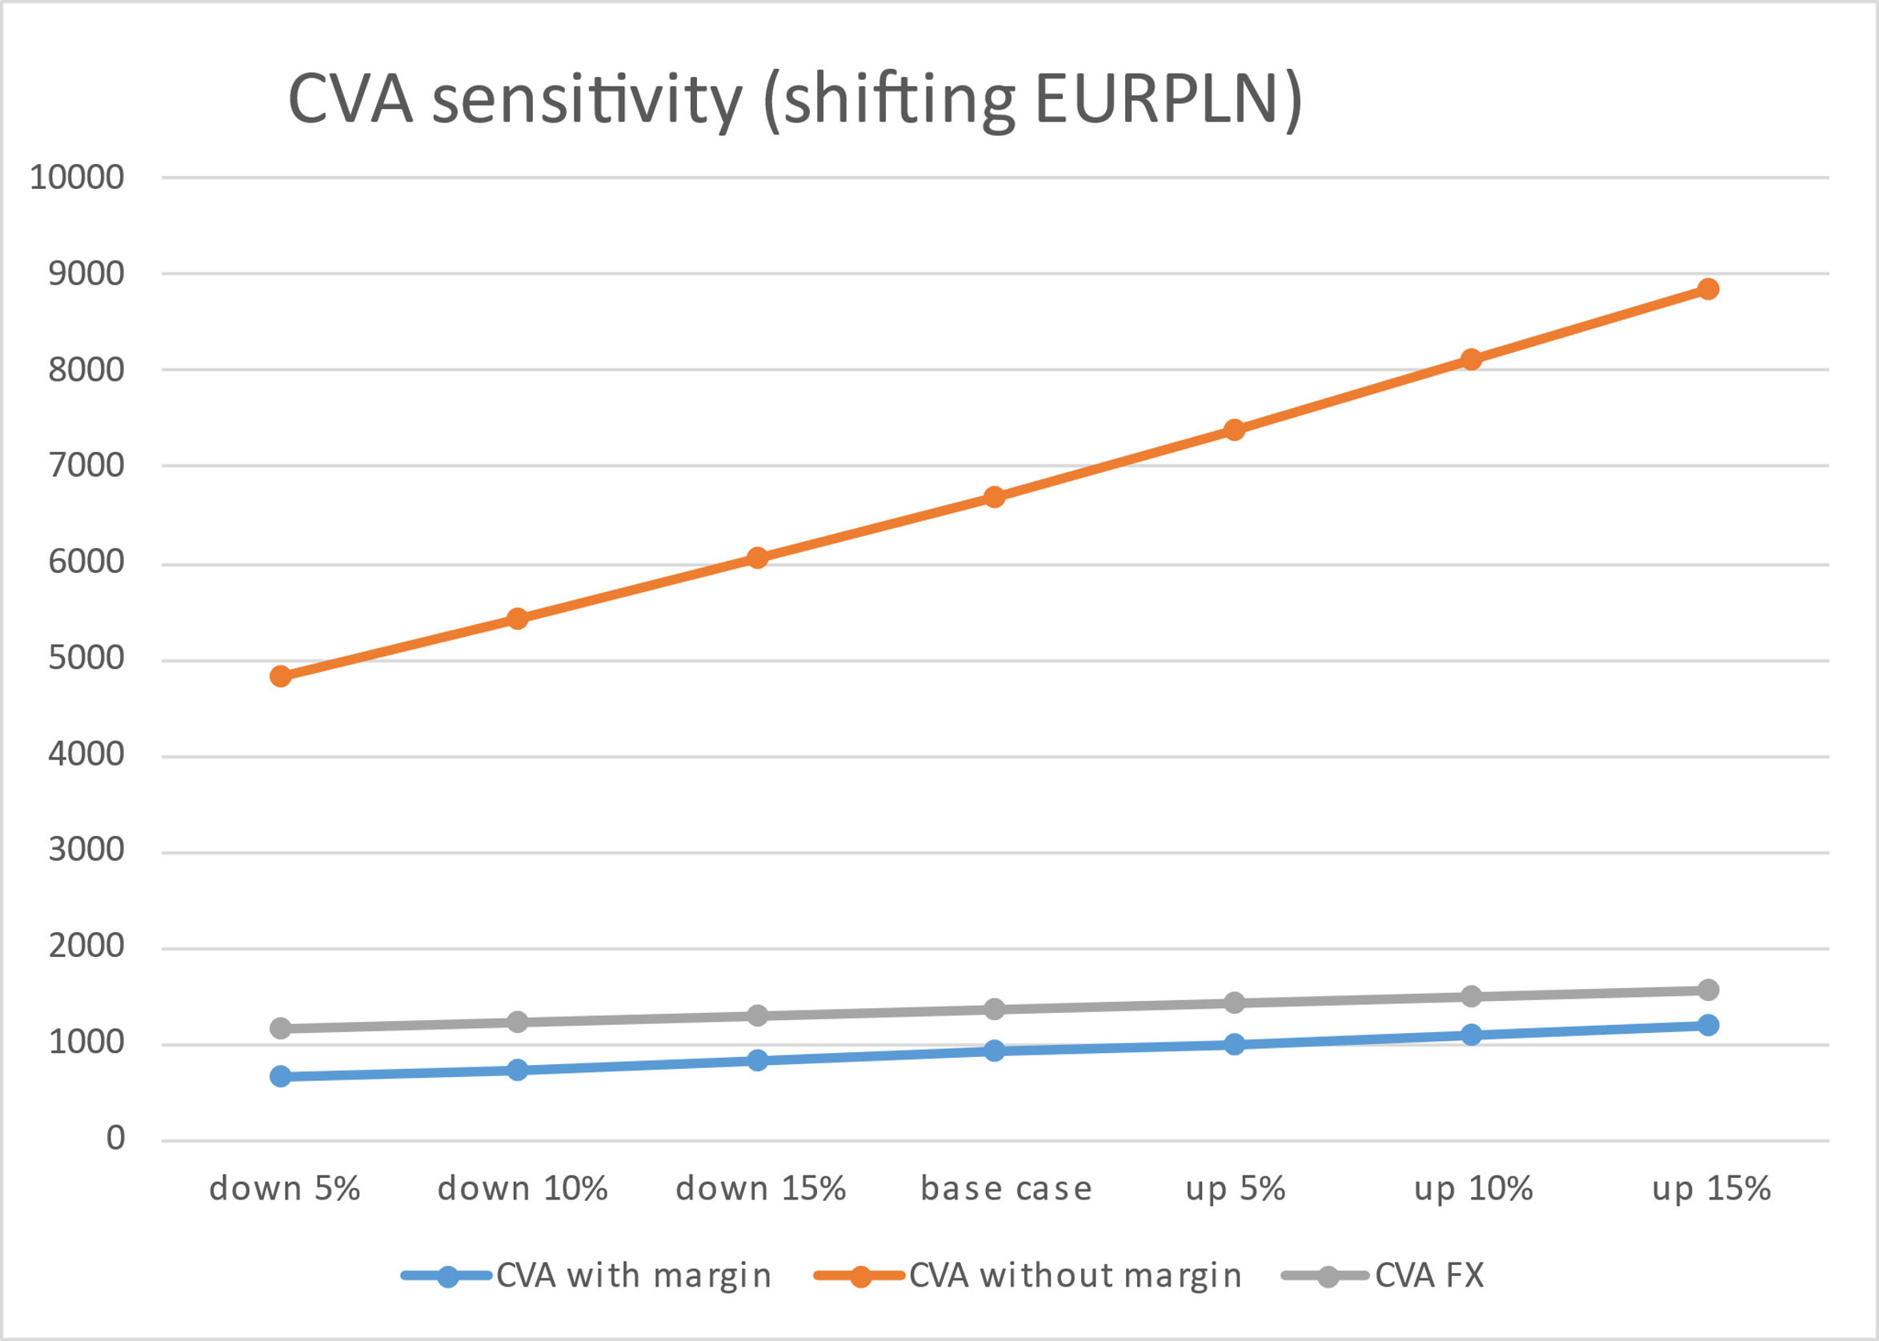
IV. Sensitivity analysis
Sensitivity analysis by changing EURPLN
Increase in realized EUR/PLN rate increases CVA of FX Forward and increases overall Portfolio CVA

Slide 14
IV. Sensitivity analysis
Sensitivity analysis by changing EURIBOR volatility
Increase in Euribor-3M volatility increase CVA of IRS, however, has little impact on Portfolio CVA due to small amount of IRS CVA

Slide 15
IV. Sensitivity analysis
Sensitivity analysis by changing recovery rate
Increase in recovery rate (or decrease in LGD rate) decreases CVA as overall credit risk decreases due to smaller expected loss

Slide 16
IV. Sensitivity analysis
Sensitivity analysis by changing recovery rate

Slide 17
IV. Sensitivity analysis
Sensitivity analysis by changing PD
Increase in probability of default increases CVA as overall credit risk increases due to higher expected loss

Slide 18
References:
https://www.ivsc.org/wp-content/uploads/2021/10/Annexe-250.02-CVA-DVA.pdf
Credit valuation adjustment for derivative contracts – Dr. Paweł Olsza
Notes:
K is the long term mean reversion coefficient
The standard deviation factor, sigma*sqrt(lambda) avoids the possibility of negative interest rates for all positive values of a and b. An interest rate of zero is also precluded if the condition 2ab>=singma^2 is met. More generally, when the rate ({\displaystyle r_{t}}) is close to zero, the standard deviation ({\displaystyle \sigma {\sqrt {r_{t}}}}) also becomes very small, which dampens the effect of the random shock on the rate. Consequently, when the rate gets close to zero, its evolution becomes dominated by the drift factor, which pushes the rate upwards.
More generally, when the rate is close to zero, the standard deviation sigma*sqrt(lambda) also becomes very small, which dampens the effect of the random shock on the rate. Consequently, when the rate gets close to zero, its evolution becomes dominated by the drift factor, which pushes the rate upwards

Slide 19
Thank you for listening!

